Slide 1
Off-lattice kinetic Monte Carlo and hydrogen vacancy-cluster interactions in α–Fe
C.J. Williams
University of Cambridge
Enrique Galindo-Nava – University College London
James Elliott – University of Cambridge
Notes:
Enter speaker notes here.

Slide 2
Outline
Motivation & intro to off-lattice KMC (OLKMC)
Accelerating OLKMC
Local environments, tolerant classification.
Self symmetries.
An adaptive catalogue.
Results
Vacancy clusters, H-complexes and lifetimes
Notes:
Enter speaker notes here.

Slide 3
H-embrittlement
mm
CM
μm
MD
nm
H-embrittlement
DFT
CC
fs
ps
ns
μs
ms
s
Notes:
Micrograph relevant – Martensitic steal
DFT vs kinetics and large scale
PLOT time vs length scales
Composition, cast iron
Microstructure
Energy separations
Hydrogen embrittlement time-scales – $O$(seconds) + length scales
High mobility
Unknown mechanisms (defect interactions)
Difficult experimentally (electron density)

Slide 4
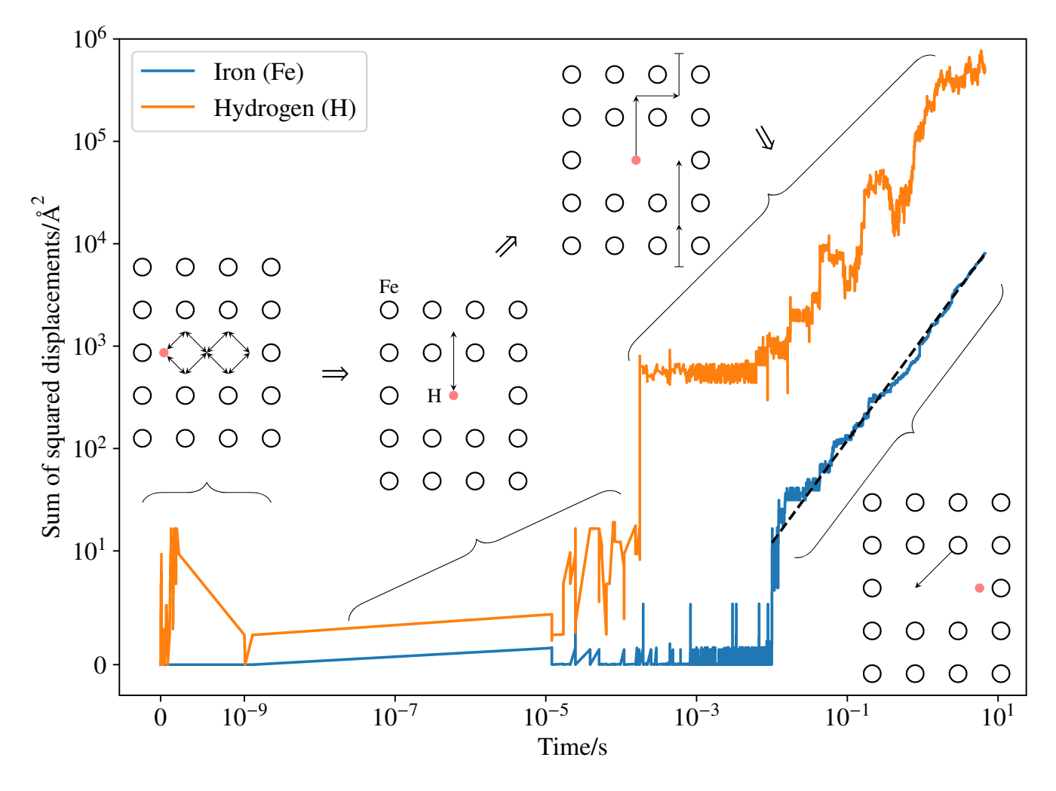
H-embrittlement
mm
CM
μm
MD
nm
H-embrittlement
DFT
CC
fs
ps
ns
μs
ms
s
Notes:
Micrograph relevant – Martensitic steal
DFT vs kinetics and large scale
PLOT time vs length scales
Composition, cast iron
Microstructure
Energy separations
Hydrogen embrittlement time-scales – $O$(seconds) + length scales
High mobility
Unknown mechanisms (defect interactions)
Difficult experimentally (electron density)

Slide 5

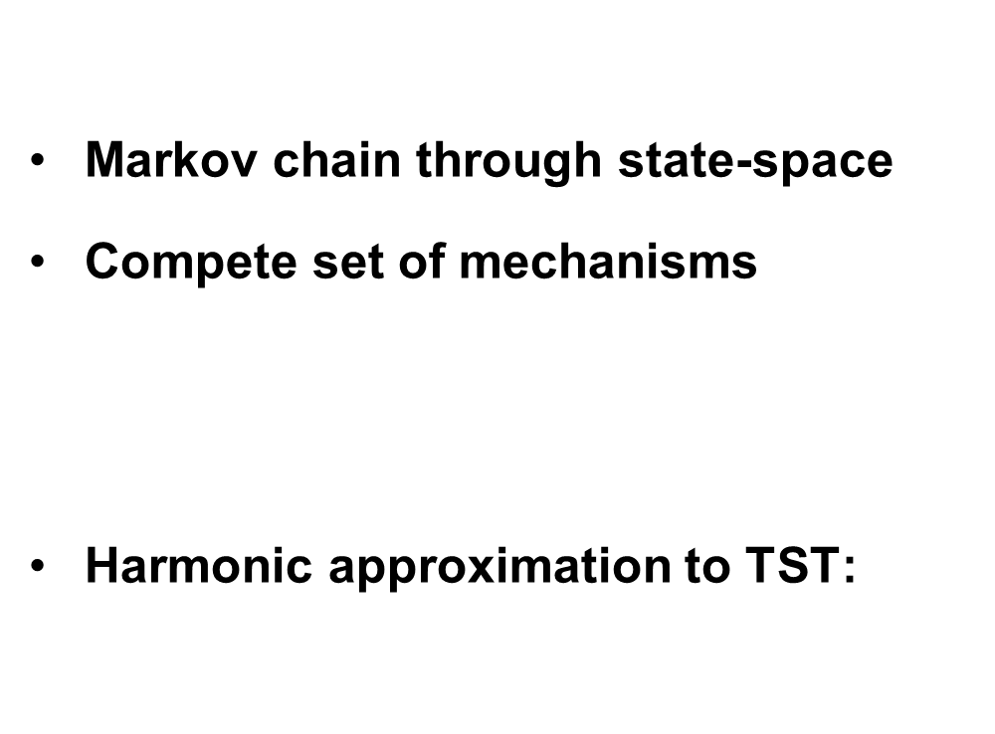



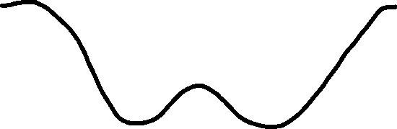
(Kinetic) Monte Carlo
Markov chain through state-space
$\text{Compete} \text{set} \text{of} \text{mechanisms}$
Harmonic approximation to TST:
Notes:
Much faster than MD – order seconds for some systems
Construct lattice such that states correspond to basins/minima of MD’s PE

Slide 6
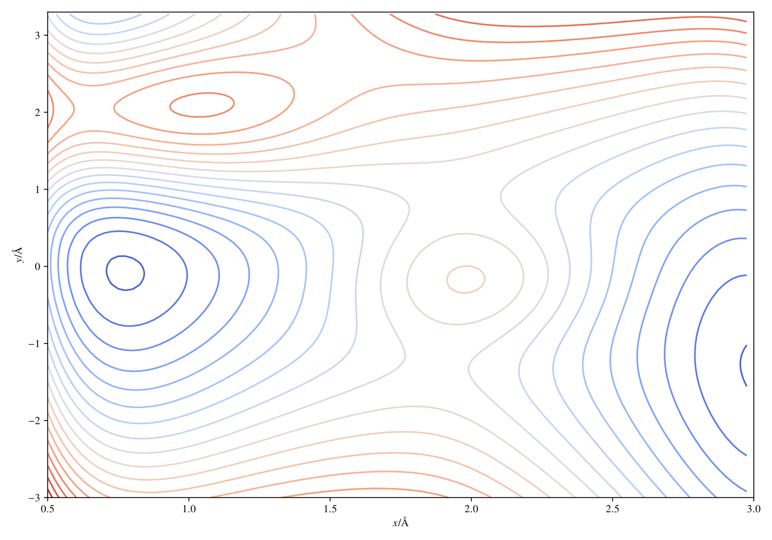
Notes:
Energy landscape in continuous picture

Slide 7




Notes:
Reference Moleclar dynamics

Slide 8
Notes:
What we want for fast (K)MC

Slide 9
Notes:
Saddle points are key – describe discrete possible transitions

Slide 10
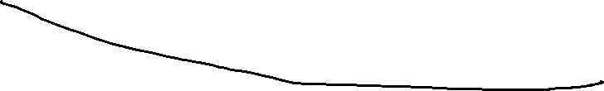

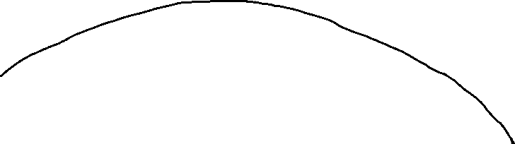

Notes:
Saddle points are key – describe discrete possible transitions
htst

Slide 11


Off-lattice KMC
Find
saddle
points
Advance
state
KMC
choose
mechanism
Notes:
Lead into find saddle points as the slow point and that this needs to be done efficiently
Kinetics, on-the-fly, arbitrary, basin-escaping.
Completeness, force-field.

Slide 12
Outline
Motivation & intro to off-lattice KMC (OLKMC)
Accelerating OLKMC
Local environments, tolerant classification.
Self symmetries.
An adaptive catalogue.
Results
Vacancy clusters, H-complexes and lifetimes
Notes:
How symmetry lest a SPS go further

Slide 13
Locality
Notes:
Reduce SPS in frame
Store, reduce SPS between frames

Slide 14
Local environments
Notes:
Reduce SPS in frame
Store, reduce SPS between frames

Slide 15
Equivalence?
Notes:
Tolerance requires a continuous heuristic

Slide 16

Invariant and tolerant equivalence

Slide 17
Invariant and tolerant equivalence

Slide 18
Invariant and tolerant equivalence

Slide 19
Invariant and tolerant equivalence

Slide 20
Invariant and tolerant equivalence

Slide 21
Invariant and tolerant equivalence
Notes:
Make connection to energy
Bad exponential complexity: exploit embedding space O(n^2) => could be O(n)
How to set delta:

Slide 22
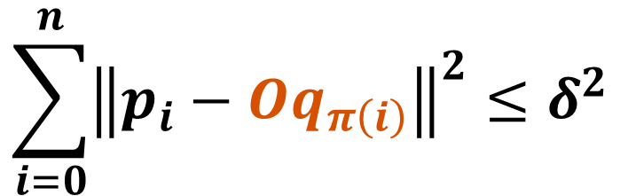
Invariant and tolerant equivalence
$$\sum_{i=0}^{n}{{\left\|p_{i}−Oq_{π\left(i\right)}\right\|}^{2}}≤δ^{2}$$
Notes:
Make connection to energy
Bad exponential complexity: exploit embedding space O(n^2) => could be O(n)
How to set delta:

Slide 23
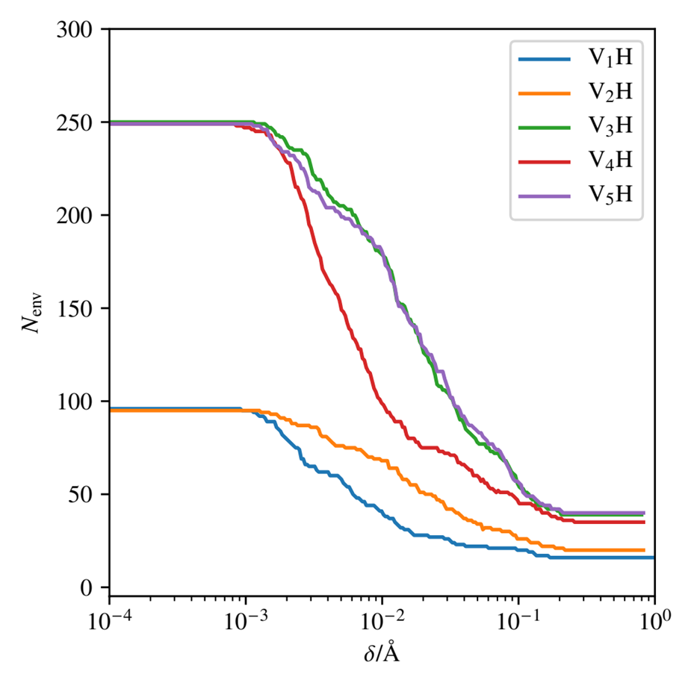
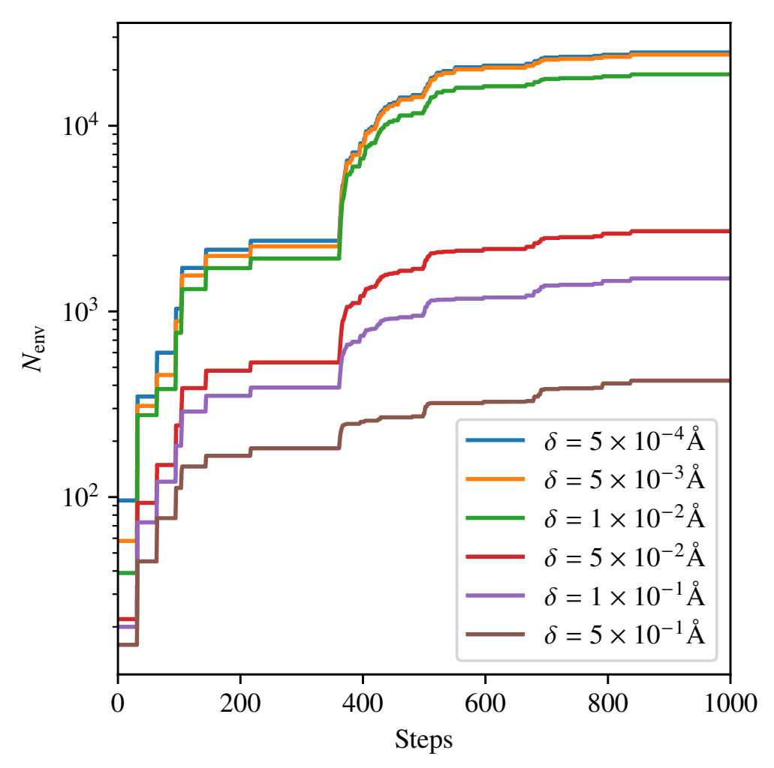
Efficiency
Notes:
N = 430ish
RHS = V1 H

Slide 24
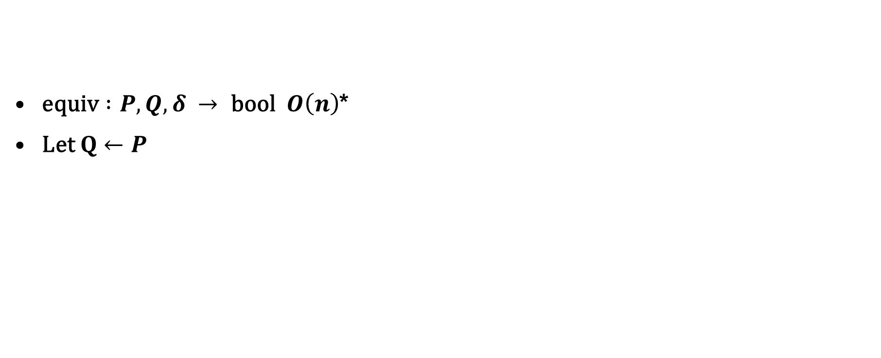

Internal symmetries
$\text{equiv} :P, Q, δ → \text{bool} O\left(n\right)$*
$\text{Let} Q←P$
Notes:
Use the same tolerance for equivalence and self symmetries

Slide 25
Adaptive $δ$

Slide 26
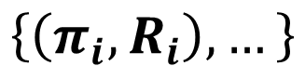
Adaptive $δ$
$$\left\{\left(π_{i}, R_{i}\right),…\right\}$$

Slide 27
Adaptive $δ$
Find:
$$\left\{\left(π_{i}, R_{i}\right),…\right\}$$
Generate:

Slide 28
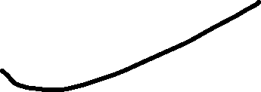
Adaptive $δ$
Find:
$$\left\{\left(π_{i}, R_{i}\right),…\right\}$$
Generate:
Test

Slide 29
Outline
Motivation & intro to off-lattice KMC (OLKMC)
Accelerating OLKMC
Local environments, tolerant classification.
Self symmetries.
An adaptive catalogue.
Results
Vacancy clusters, H-complexes and lifetimes
Notes:
Enter speaker notes here.

Slide 30
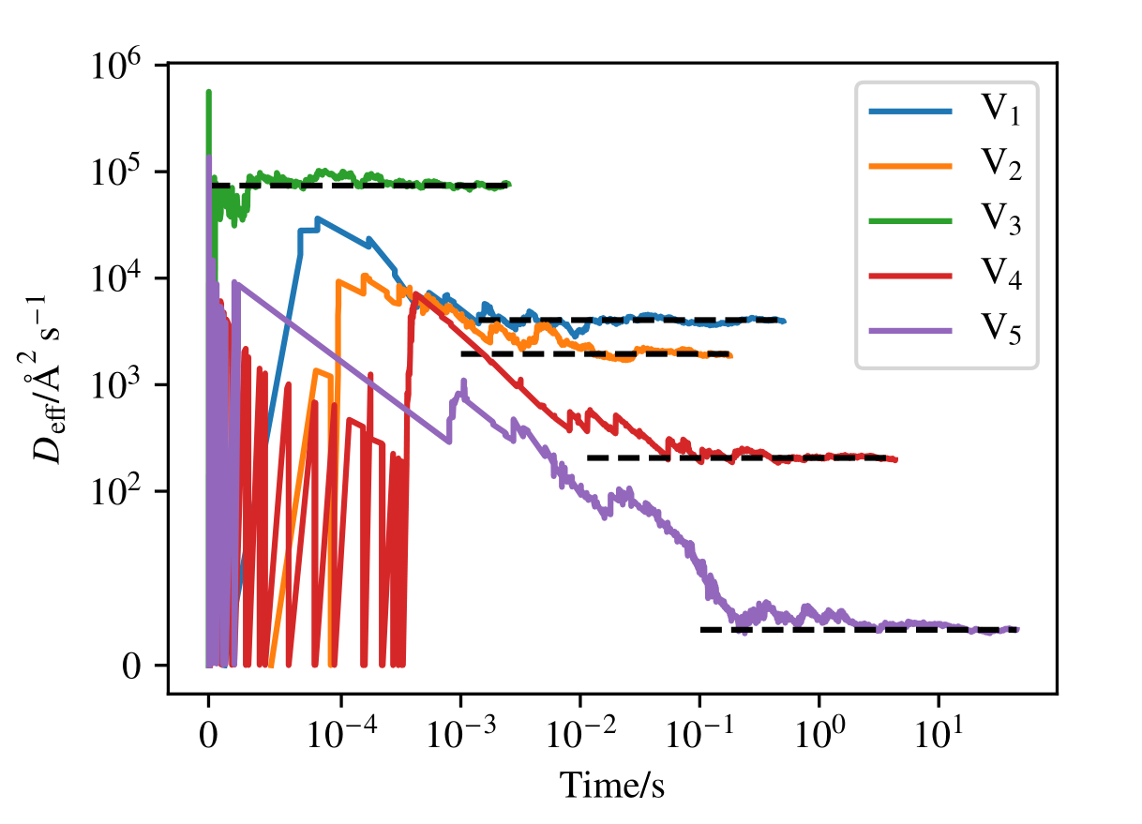

Slide 31
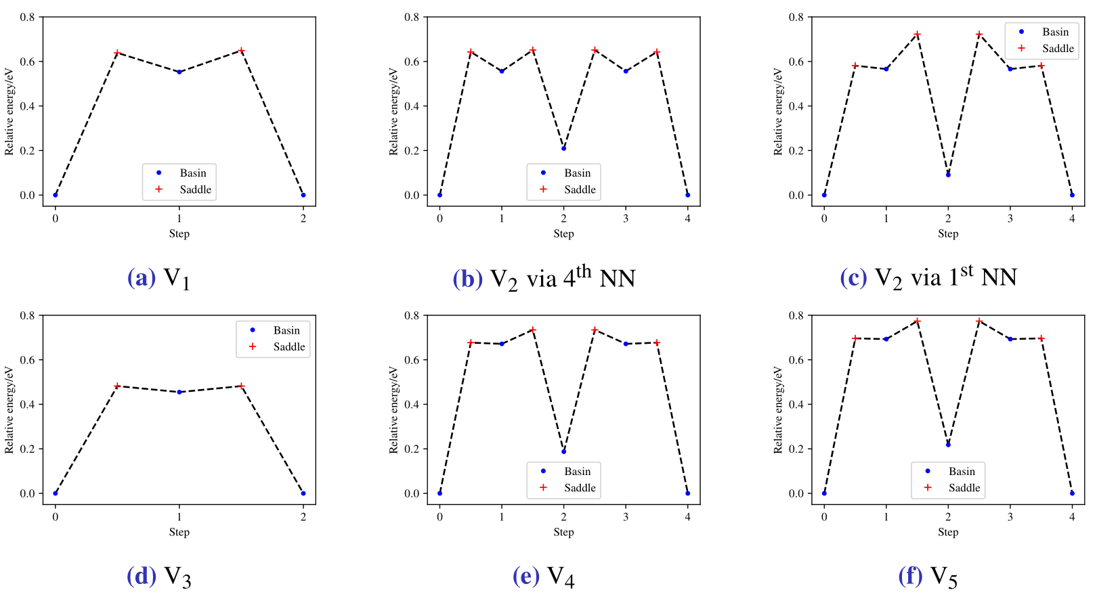

Slide 32
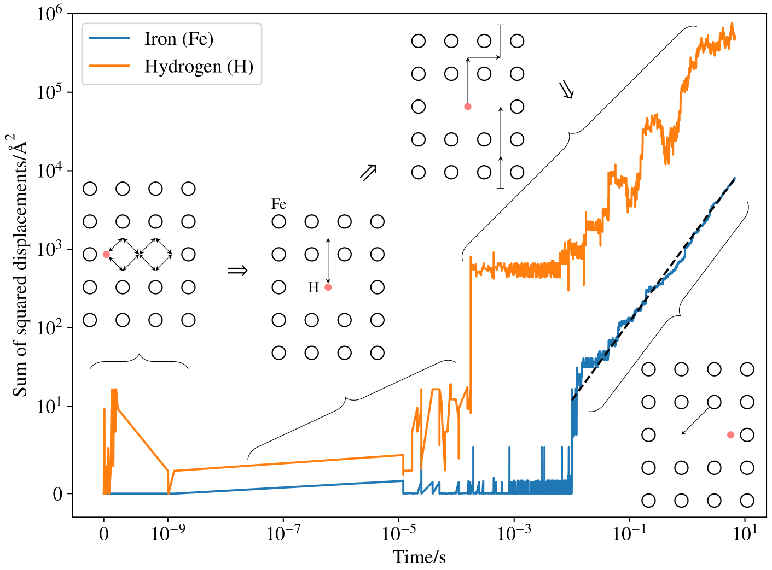

Slide 33
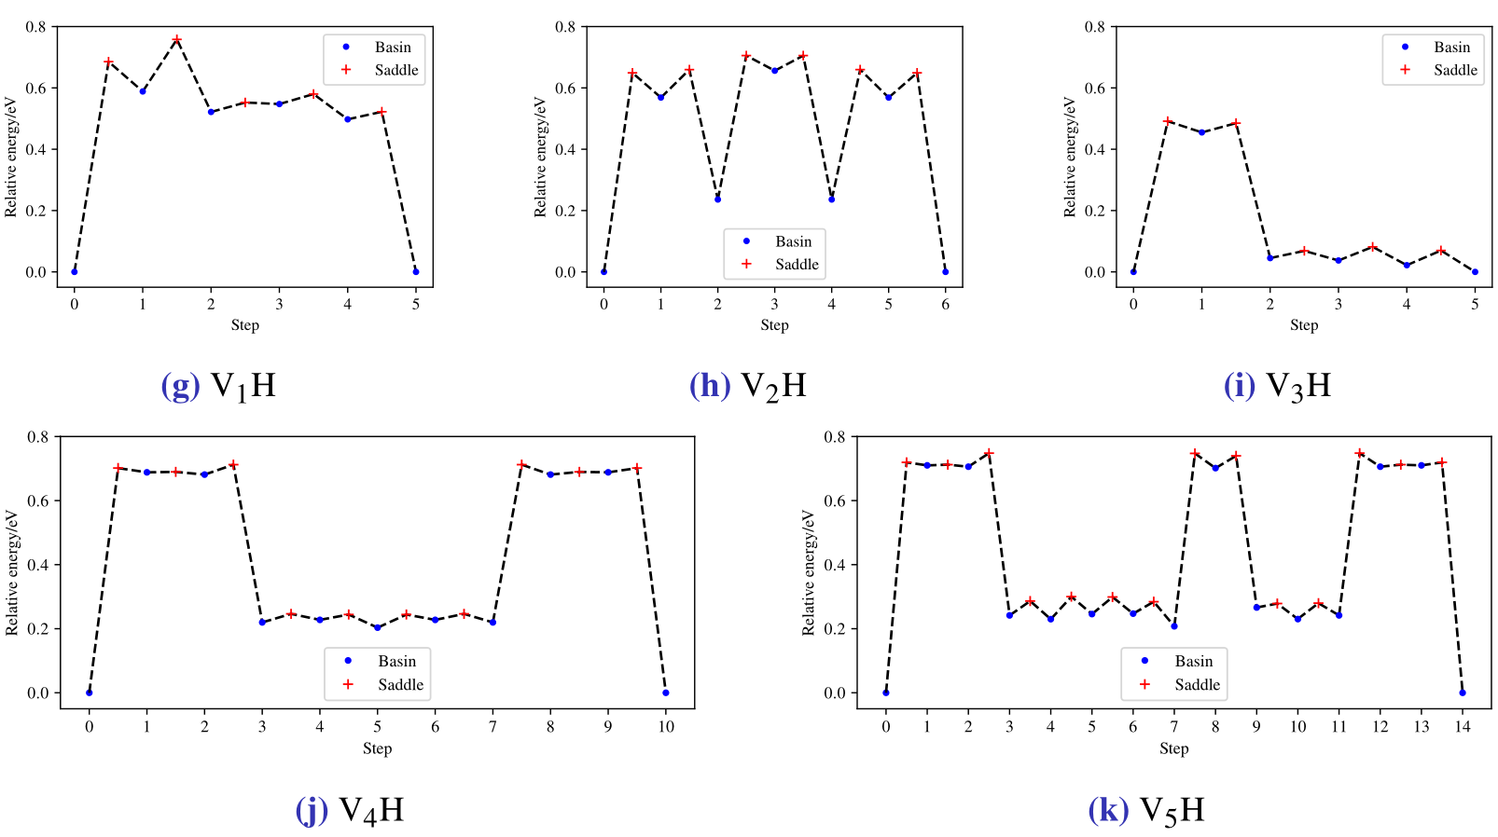
Notes:
Effect of H vs H free case

Slide 34
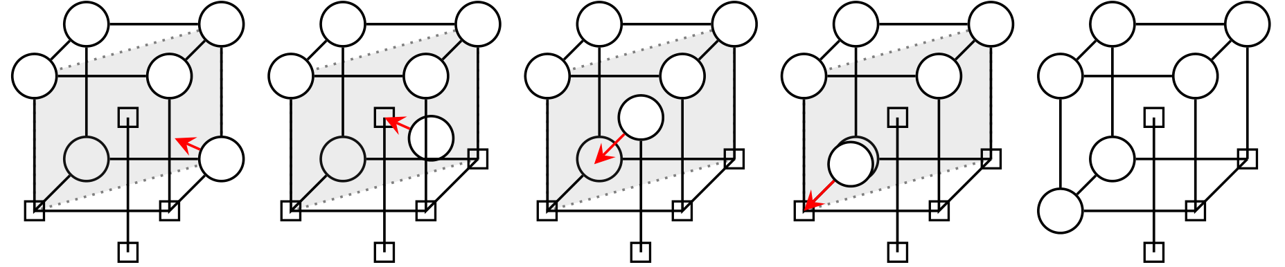
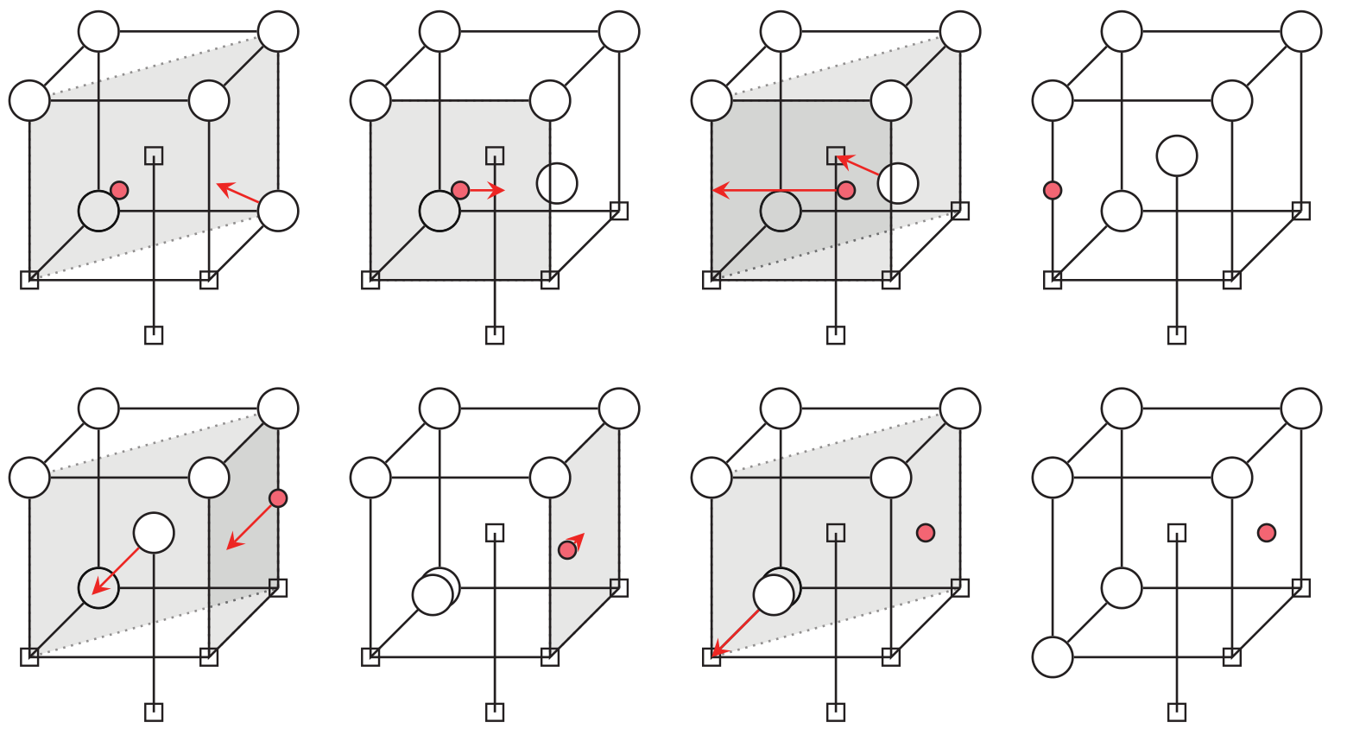


Notes:
Effect of H vs H free case

Slide 35
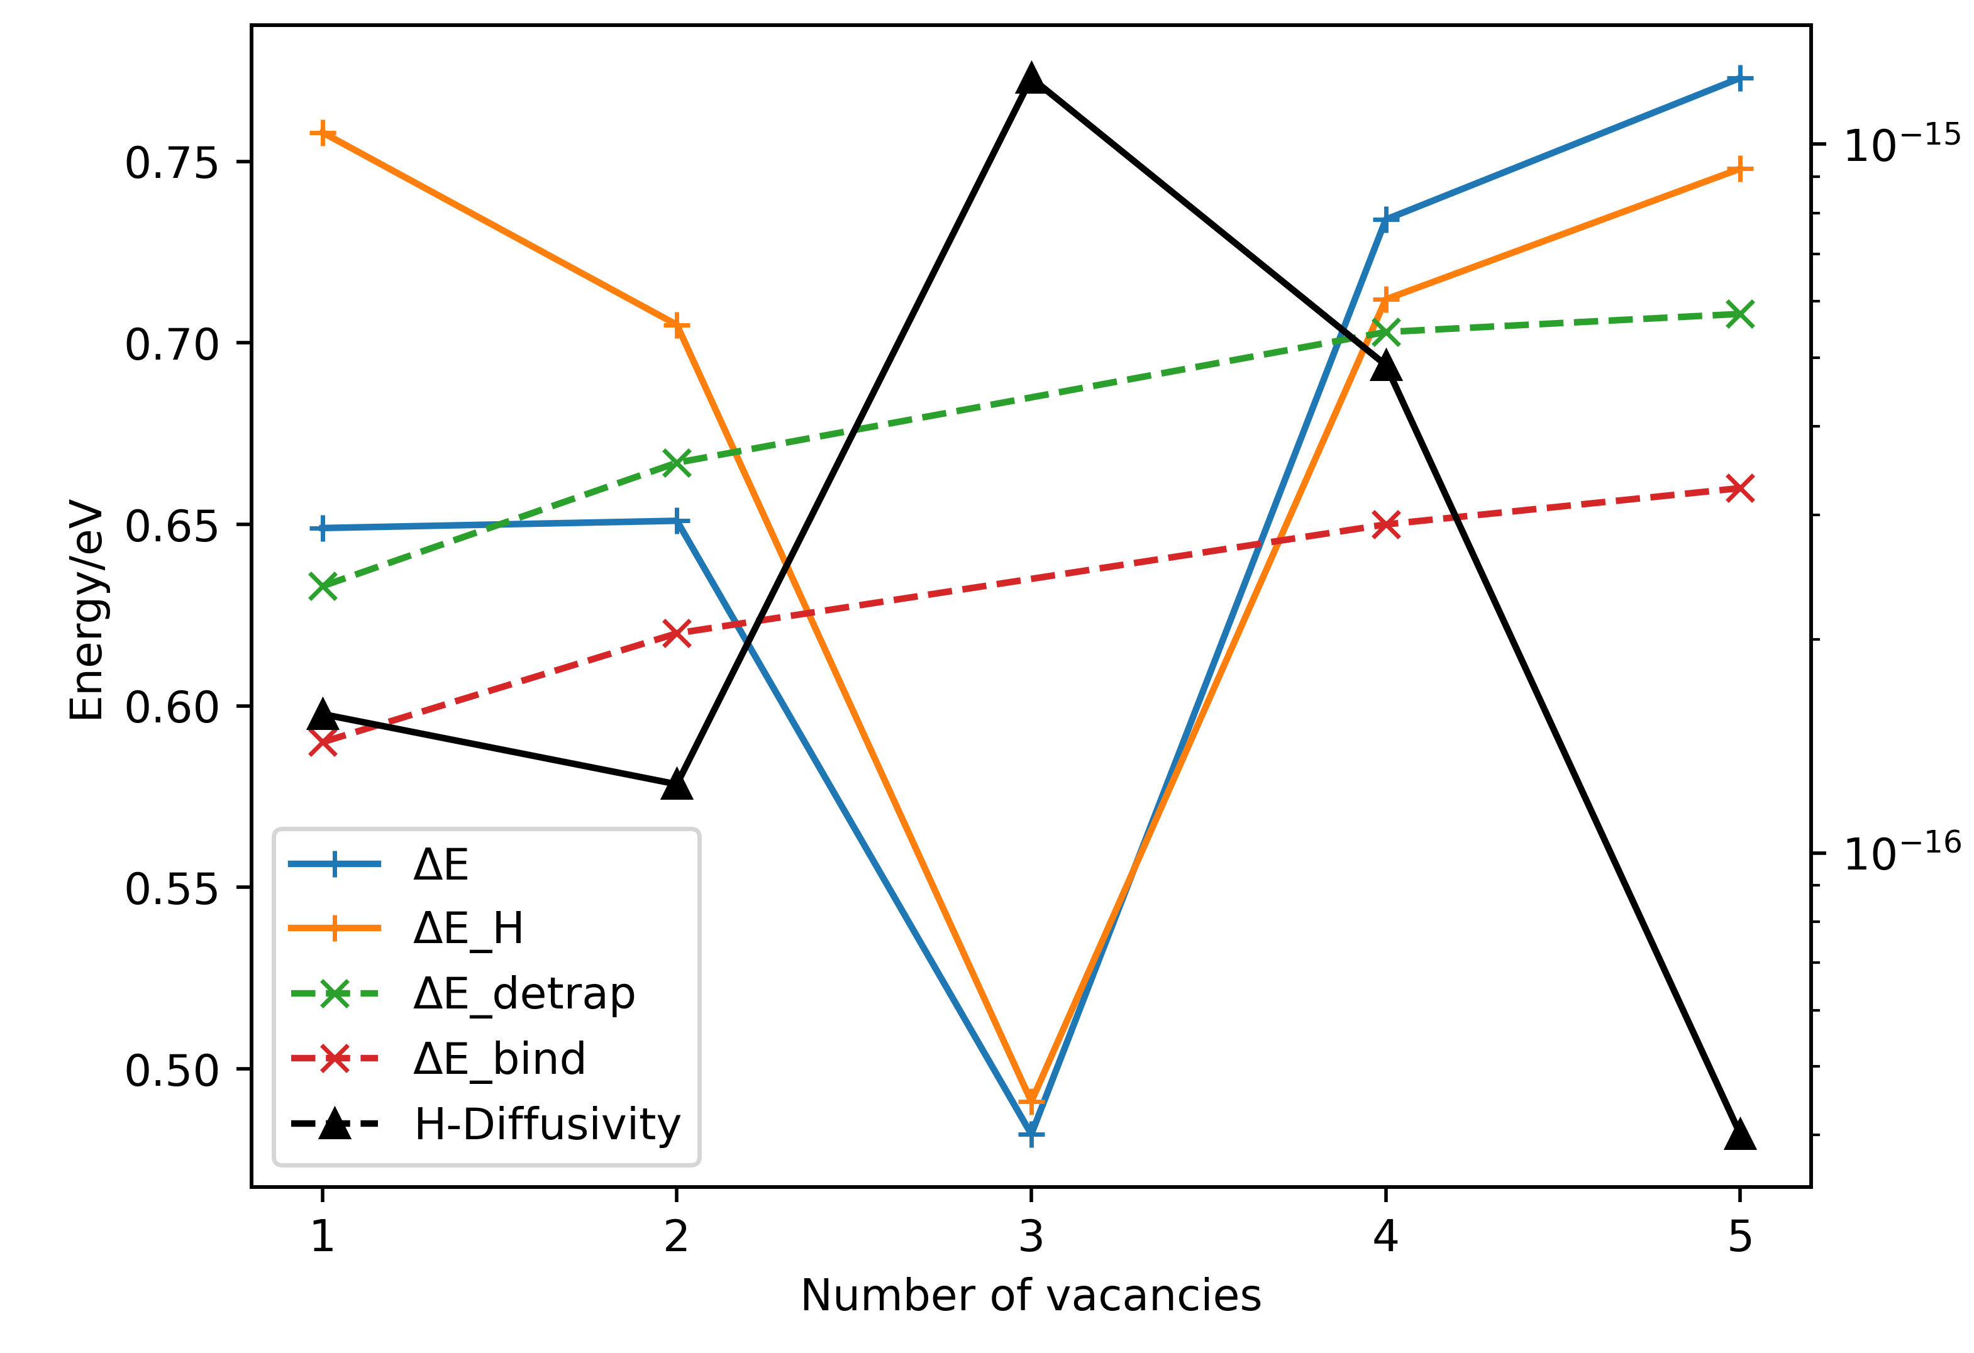
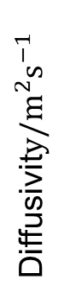
Diffusivit$y{\text{/}\text{m}}^{2}{\text{s}}^{−1}$
Notes:
Graph
Vacancies
Diffuse

Slide 36
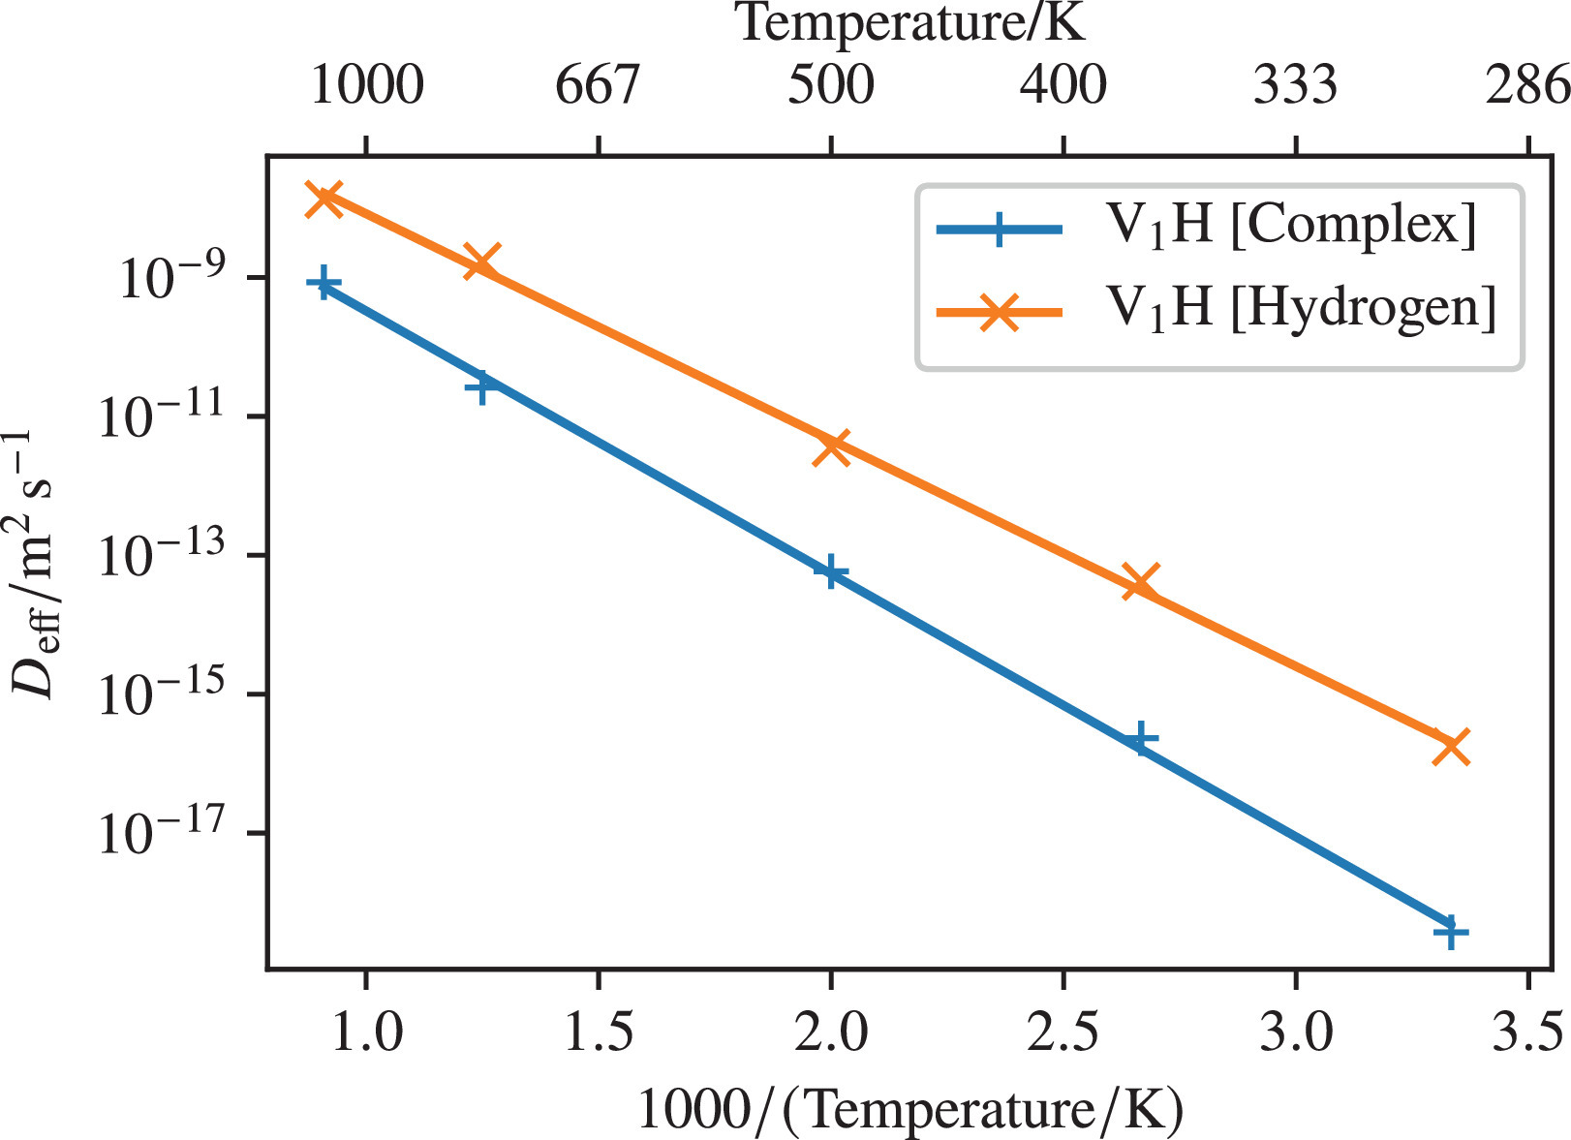

Slide 37
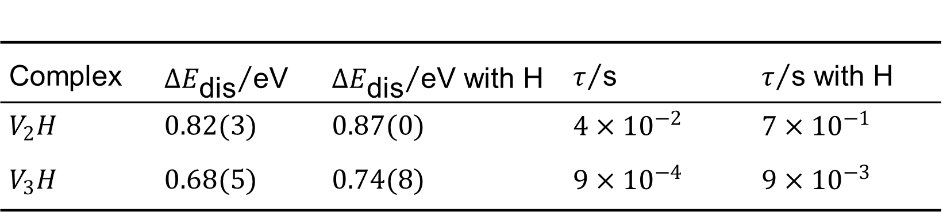
*preliminary
Complex | ${∆E_{\text{dis}}}/{\text{eV}}$ | ${∆E_{\text{dis}}}/{\text{eV}}$ with H | $τ/{\text{s}}$ | $τ/{\text{s}}$ with H
$$V_{2}H$$ | $$0.82(3)$$ | $$0.87(0)$$ | $$4×{10}^{−2}$$ | $$7×{10}^{−1}$$
$$V_{3}H$$ | $$0.68(5)$$ | $$0.74(8)$$ | $$9×{10}^{−4}$$ | $$9×{10}^{−3}$$

Slide 38
Summary
Tolerant, invariant and continuous equivalence
Adaptive catalogue
Classified complexes’ diffusion pathways
Hydrogen can lower diffusion barrier
H de-trapping barrier(s) from clusters
H effective diffusivity
Quantified the trapping atmospheres surrounding vacancy clusters
Cluster lifetimes
Notes:
Take away
PAPER LINK

Slide 39
Try openFLY - github.com/ConorWilliams/openFLY
Fully documented
Parallelised
Open source
Implements all discussed and more (graph based methods, etc)
Supports the GSD format
Supports openKIM (EAM, DUNN, EMT, EDIP, MEAM, hNN, LJ_*, Tersoff, …)
Notes:
Enter speaker notes here.
MOVE UP

Slide 40
Acknowledgements
We gratefully acknowledge the funding received from the EP-SRC via the CDT in Computational Methods for Materials Science (Grant number EP/L015552/1) and grant EP/T008687/2.
E. I. Galindo-Nava acknowledges the Royal Academy of Engineering for his research fellowship funding.
We also acknowledge Rolls-Royce PLC for the provision of funding. All information and foreground intellectual property generated by this research work is the property of Rolls-Royce PLC.
Notes:
Enter speaker notes here.

Slide 41
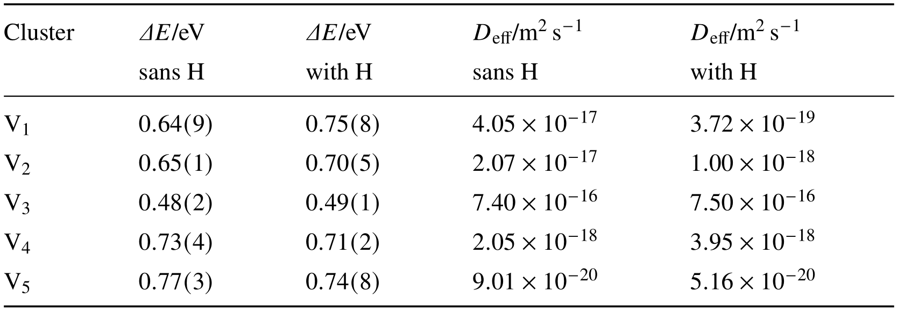
Complex diffusion
Notes:
Graph

Slide 42
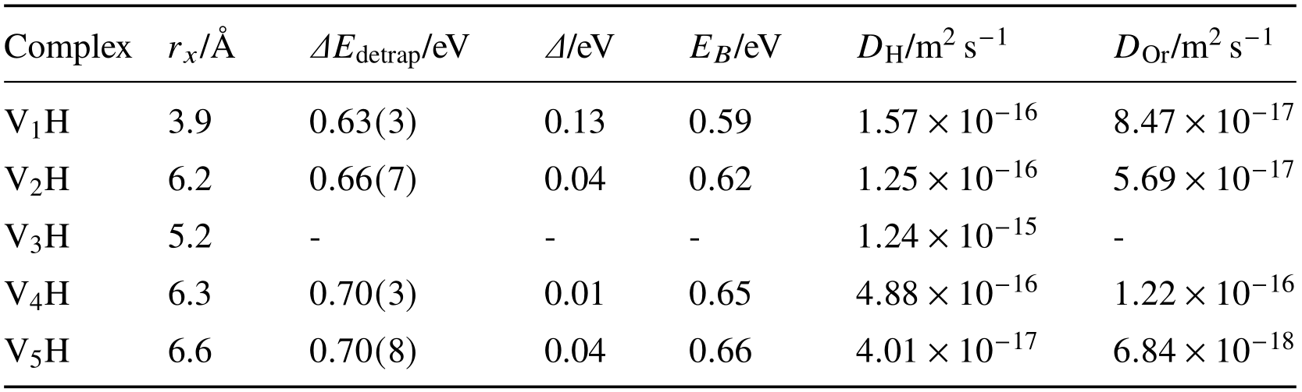
H parameters

Slide 43
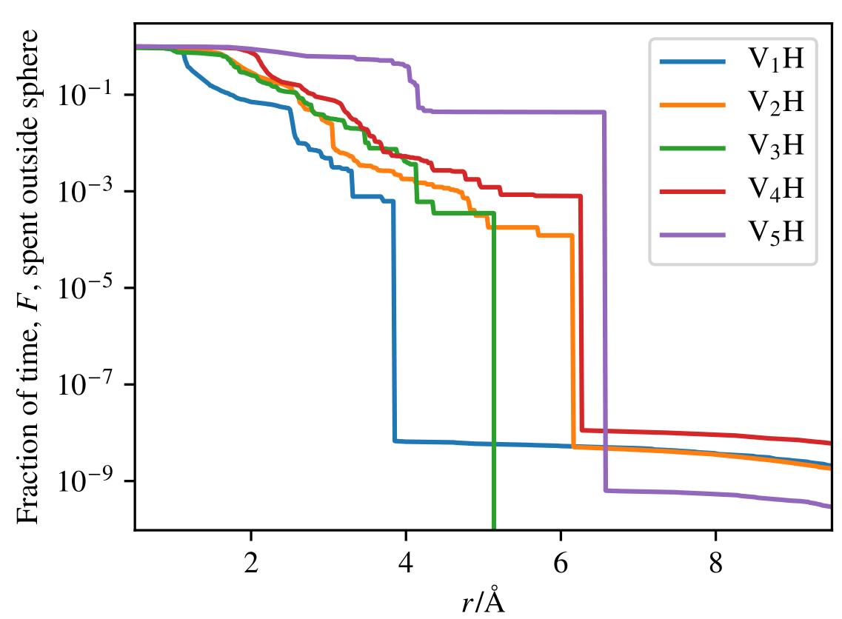
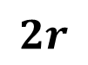
$$2r$$

Slide 44
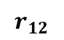

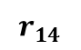

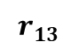
Symmetries and local environments
$$r_{13}$$
Euclidean
invariants
$$r_{12}$$
$$r_{14}$$
Notes:
Intra atomic
Euclidean

Slide 45
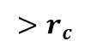


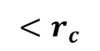


Topological representation
$$<r_{c}$$
$$>r_{c}$$
Adjacency
Notes:
Numbers
Adjacency matrix
Test for graph isomorphisms

Slide 46



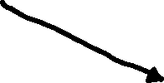
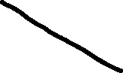
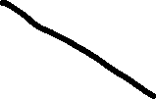
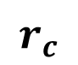
Topological representation - problems
$$r_{c}$$
Notes:
Also not sensitive to small changes in structure, i.e induced by small H movements

Slide 47
Topological representation - problems
Notes:
Also not sensitive to small changes in structure, i.e induced by small H movements

Slide 48
Topological representation - problems
Notes:
Also not sensitive to small changes in structure, i.e induced by small H movements

Slide 49
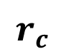

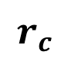

Topological representation - problems
$$r_{c}$$
$$r_{c}$$
Notes:
Also not sensitive to small changes in structure, i.e induced by small H movements

Slide 50



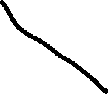
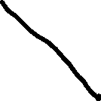

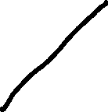
Topological representation - problems
Notes:
Also not sensitive to small changes in structure, i.e induced by small H movements

Slide 51
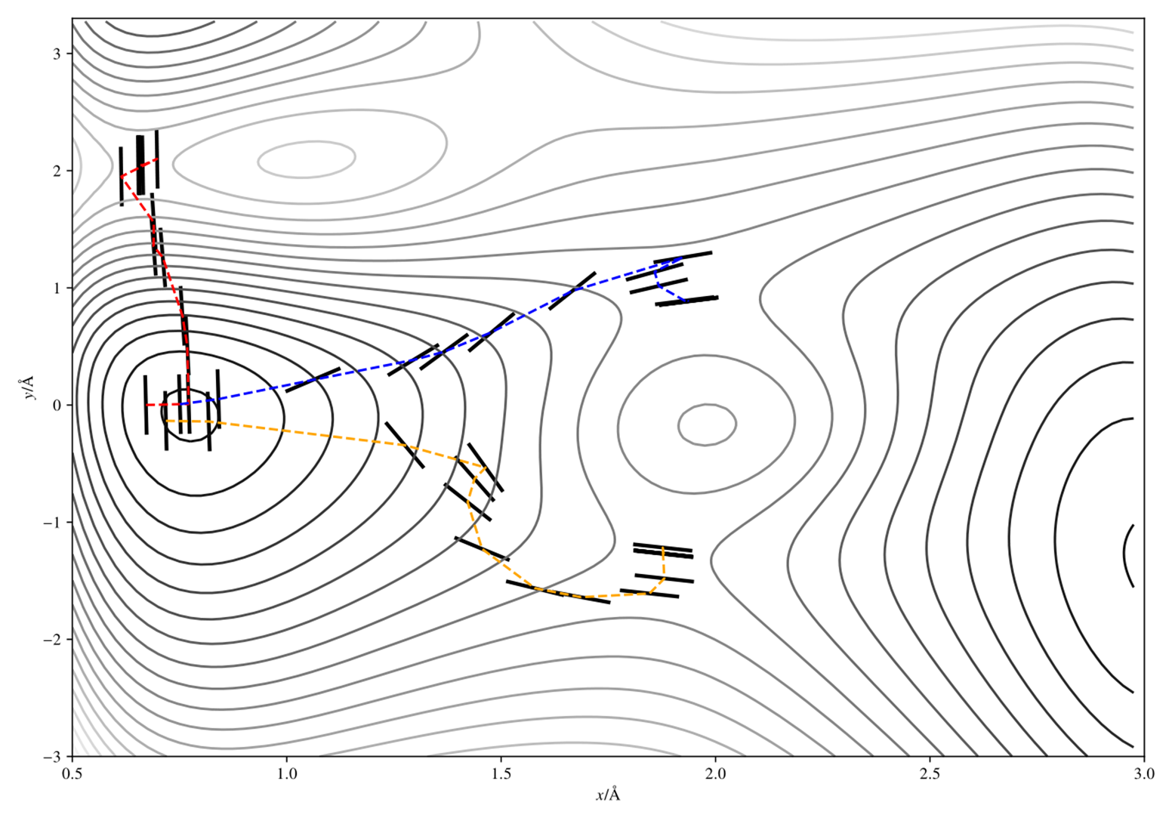


Notes:
Explain dimer method – invert component of force parallel to min eigenmode
Discovers mechanisms without any input or hints
PAPER
Summary: find SP; compute rates using HTST; choose mech (KMC); progress time (KMC)

Slide 52

Hierarchical catalogue
$${+ δ}_{\text{max}} +$$

Slide 53


Hierarchical catalogue
$${+ δ}_{\text{max}} +$$

Slide 54


Hierarchical catalogue
$${+ δ}_{\text{max}} +$$

Slide 55
Hierarchical catalogue
$${+ δ}_{\text{max}} +$$
Notes:
RM acronyms simpliy
Same size

Slide 56
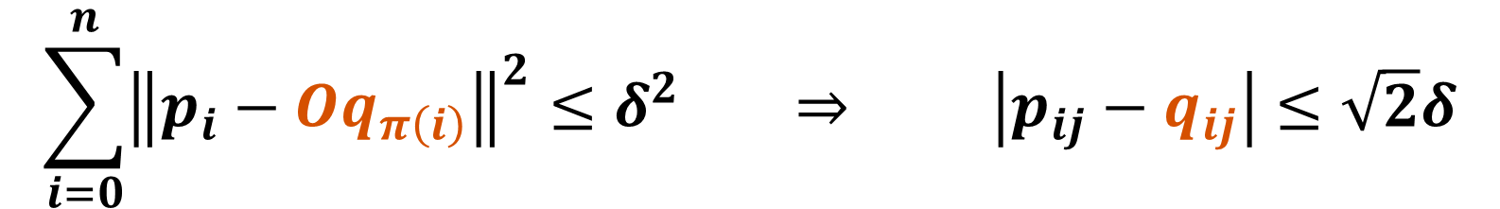
Invariant and tolerant equivalence
$$\sum_{i=0}^{n}{{\left\|p_{i}−Oq_{π\left(i\right)}\right\|}^{2}}≤δ^{2} ⇒ \left|p_{ij}−q_{ij}\right|≤\sqrt{2}δ$$

Slide 57


Greedy algorithm

Slide 58

Greedy algorithm

Slide 59



Greedy algorithm

Slide 60


Greedy algorithm

Slide 61


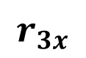
Exponential?
$$r_{1x}$$
$$r_{2x}$$
$$r_{3x}$$

Slide 62

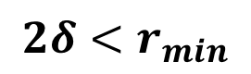
Exponential?
$$2δ<r_{min}$$

Slide 63
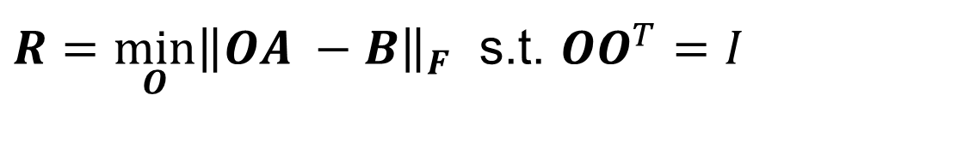
Rotation
Given permutation that satisfies equivalence
Orthogonal Procrustes problem:
Solution via SVD
$R=\min_{O}{{\left\|OA −B\right\|}_{F}}$ s.t. $OO^{T}=I$

Slide 64
Adaptive catalogue

Slide 65


Adaptive catalogue

Slide 66


Adaptive catalogue

Slide 67

Adaptive catalogue
Test

Slide 68

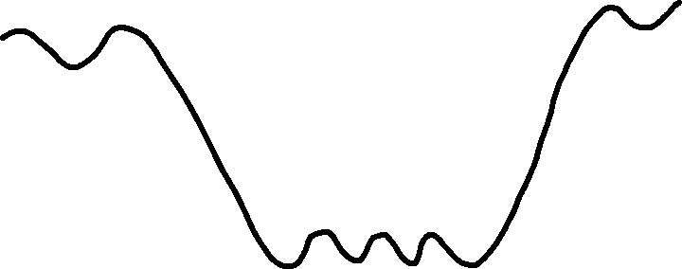
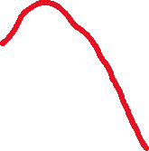




The flickering problem
Notes:
Particular problem in Fe-H system as Tet->Tet H transition energy barrier order of magnitude lower energy barrier

Slide 69










Superbasins
Partition mechanisms into transient and absorbing:
Notes:
Build Superbasins on the fly
Compute mean residence time in basin (matrix transformation)

